Slide 1
ADS MIDTERM PROJECT
Under the guidance of Professor Srikanth Krishnamurthy
Team 6:
Yamini Sehrawat
Puneeth Kumar
Vaidehi Deshpande

Slide 2
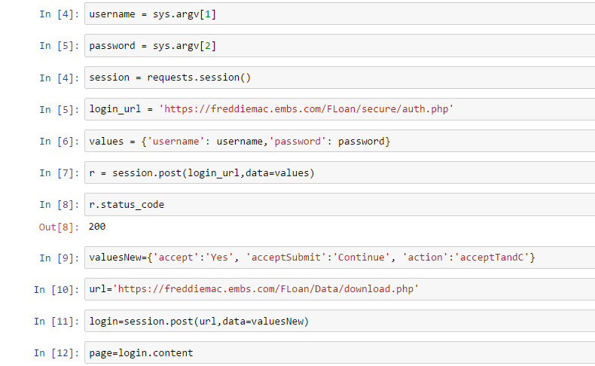

User Login
We have used requests module from python to create session and save username and password
User will enter credentials at command line, the script will check if they are valid and proceed with further actions
If credentials are incorrect or user account does not exist message will be displayed to user

Slide 3
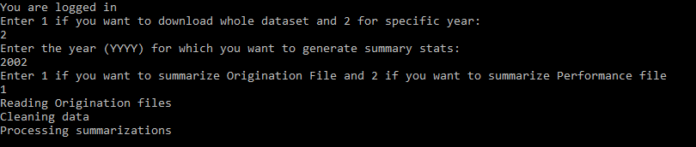
User Interaction and File Download
We have created an interactive session with user to ask what files need to be downloaded
User can choose a specific year and perform summarization or summarize the entire dataset

Slide 4
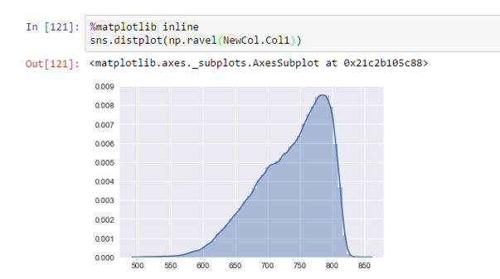
Handling Missing Data and Cleaning Data
Continuous Variables:
Replace missing data by 0 – Monthly Performance Files
Replace missing data values by mean or median
2. Categorical Variables:
Replace missing values by mode
Replace blank spaces by “NA”, “U” where applicable

Slide 5
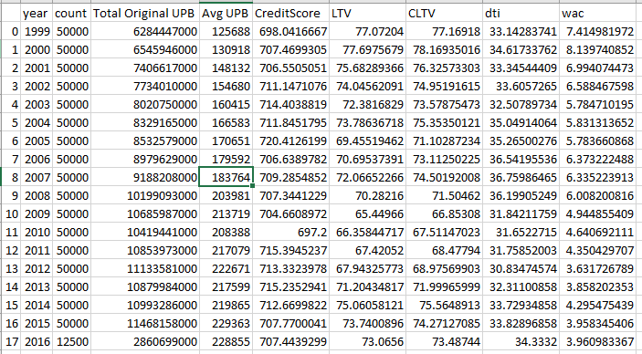
Summarization
Origination full dataset summary statistics

Slide 6
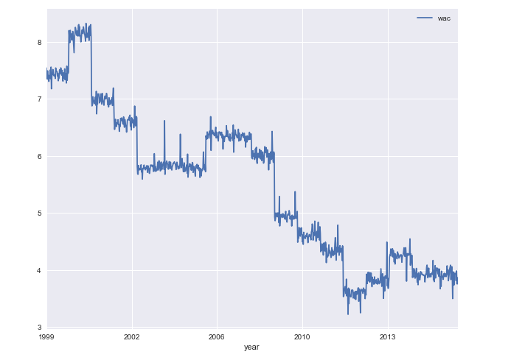
Summarization Contd..
Python graph for average Interest per year:

Slide 7
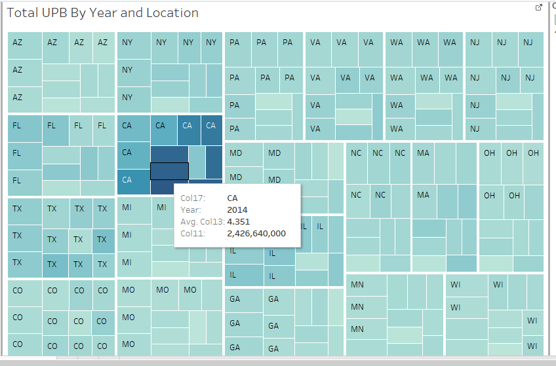
Summarization Contd..
Top 20 states based on total UPB 2005 onwards:

Slide 8
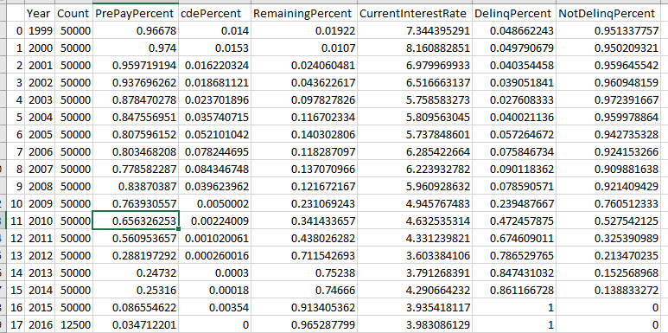
Summarization Contd..
Monthly Performance full dataset:

Slide 9
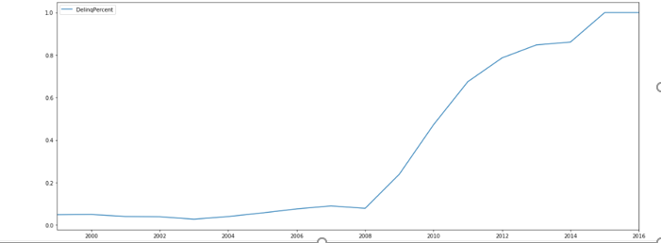
Summarization Contd..
Monthly Performance full dataset Delinquency trends:

Slide 10
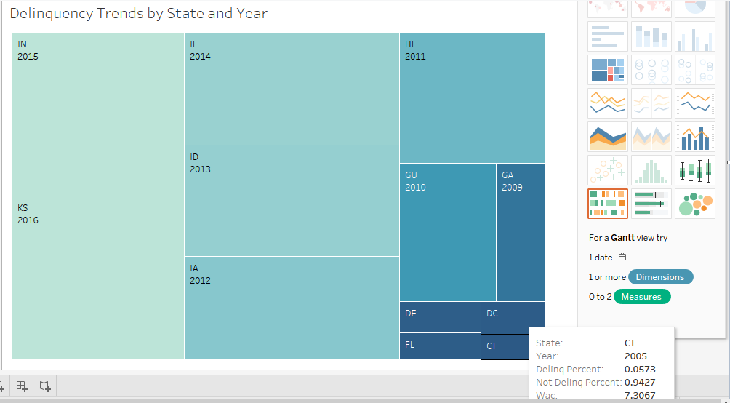
Delinquency and Interest Rate by Year and State

Slide 11
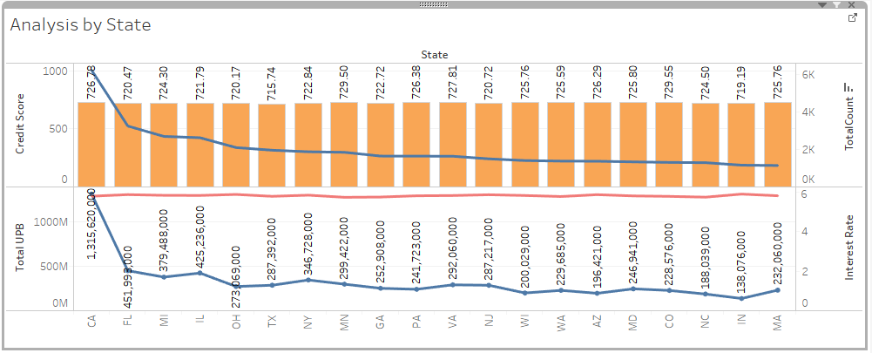
Summarization Contd..
Origination 1 year analysis:

Slide 12
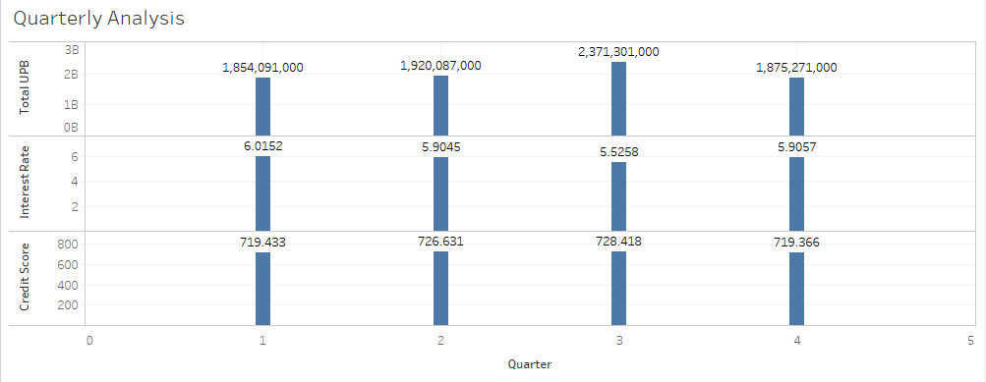
Summarization Contd..
Origination 1 year analysis:

Slide 13
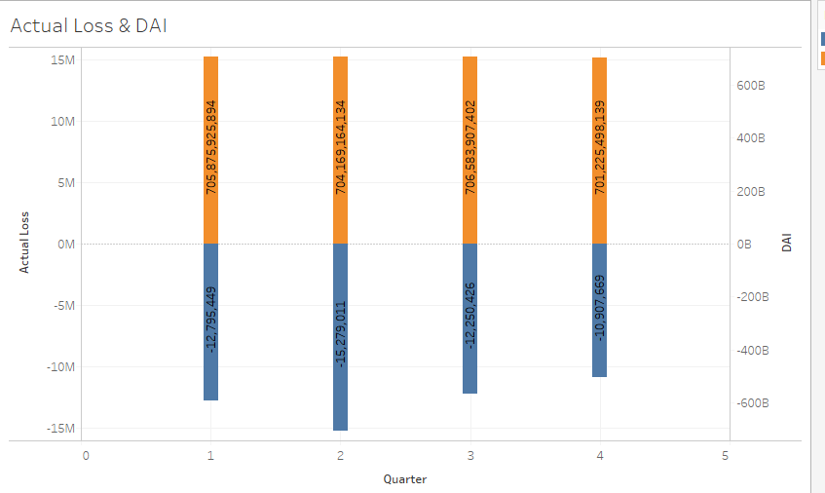
Summarization Contd..
Performance 1 year analysis:

Slide 14
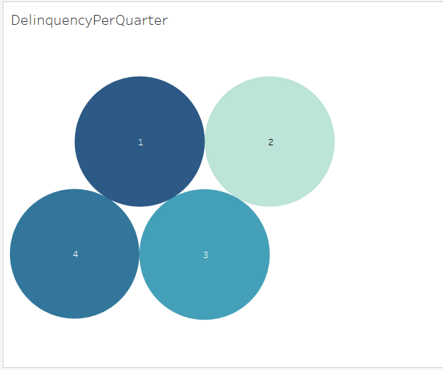
Summarization Contd..
Performance 1 year analysis:

Slide 15
LINEAR REGRESSION
Model Prediction and evaluation metrics:
(array([ 5.74995348, 5.62244285, 5.7265196 , ..., 6.00641581,
6.07177263, 6.06140455]),

Slide 16
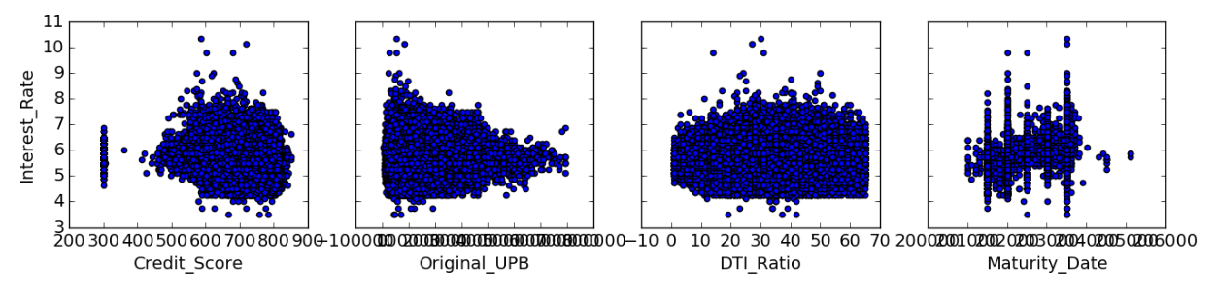
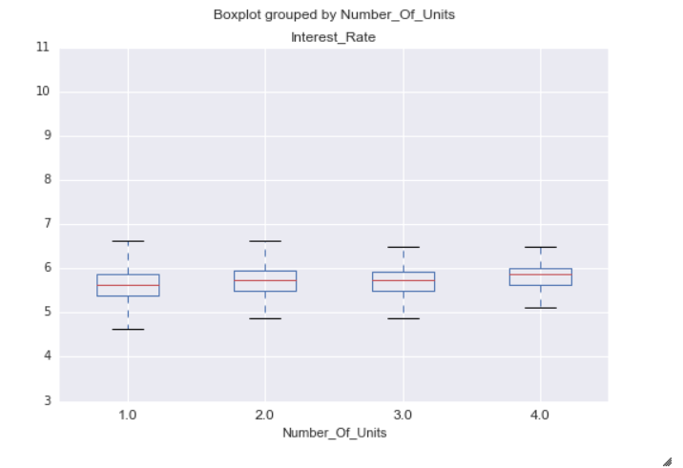
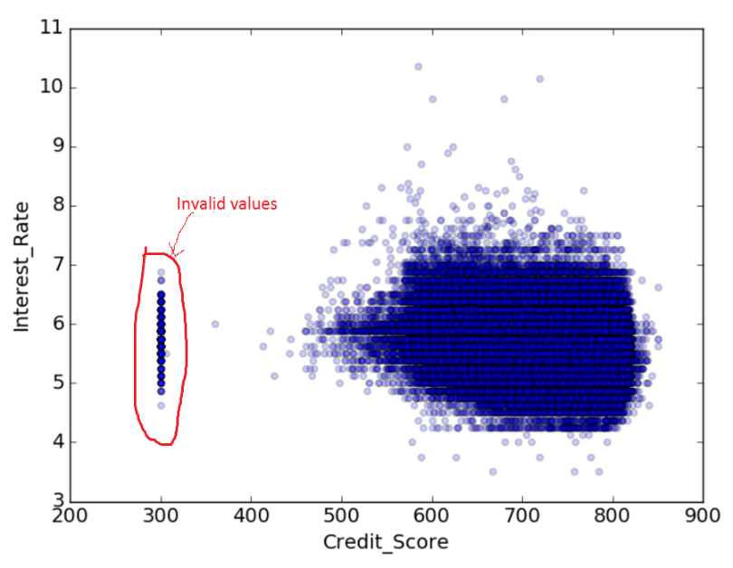
LINEAR REGRESSION VISUALIZATION

Slide 17
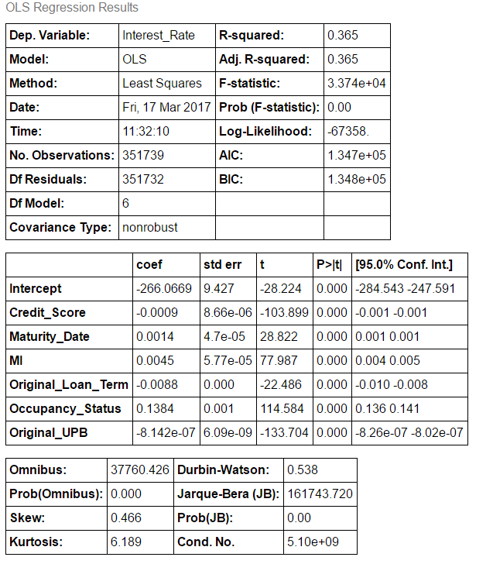
FEATURE SELECTION

Slide 18
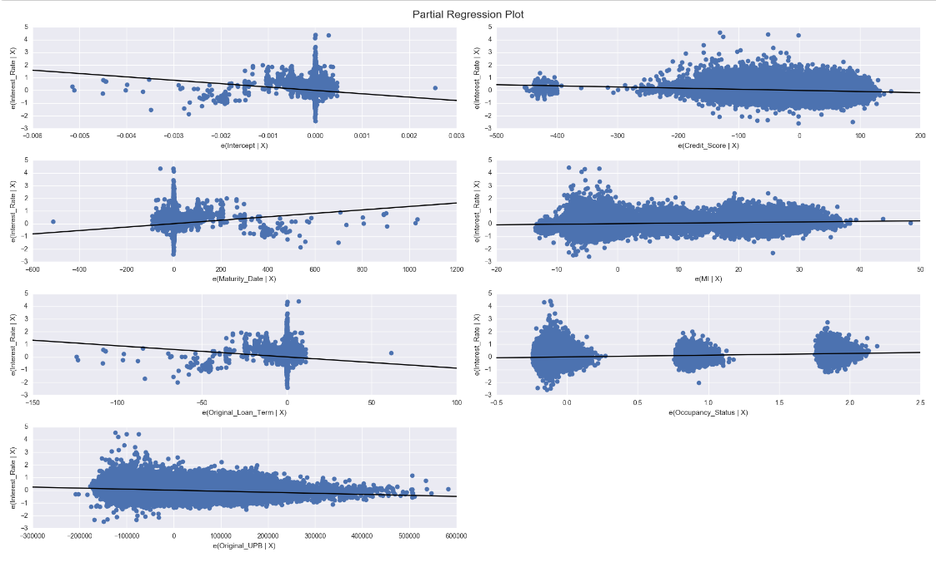

Slide 19
KNN SELECTION
RMSE : 0.36305893676002154
MAE: 28146139017554067
MAPE: 4.8163083099684156
Neural Networks

Slide 20
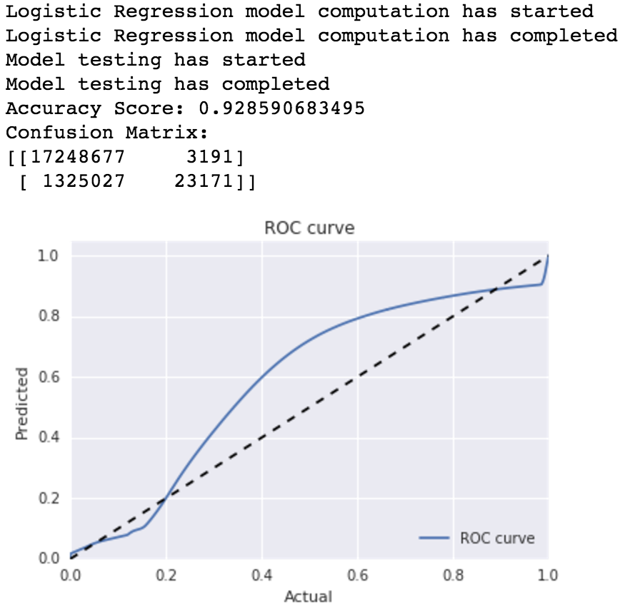
CLASSIFICATION
Classification algorithms on 13 features:
Logistic Regression Output: (Q1 2006 for Training and Q2 2006 for Testing):

Slide 21
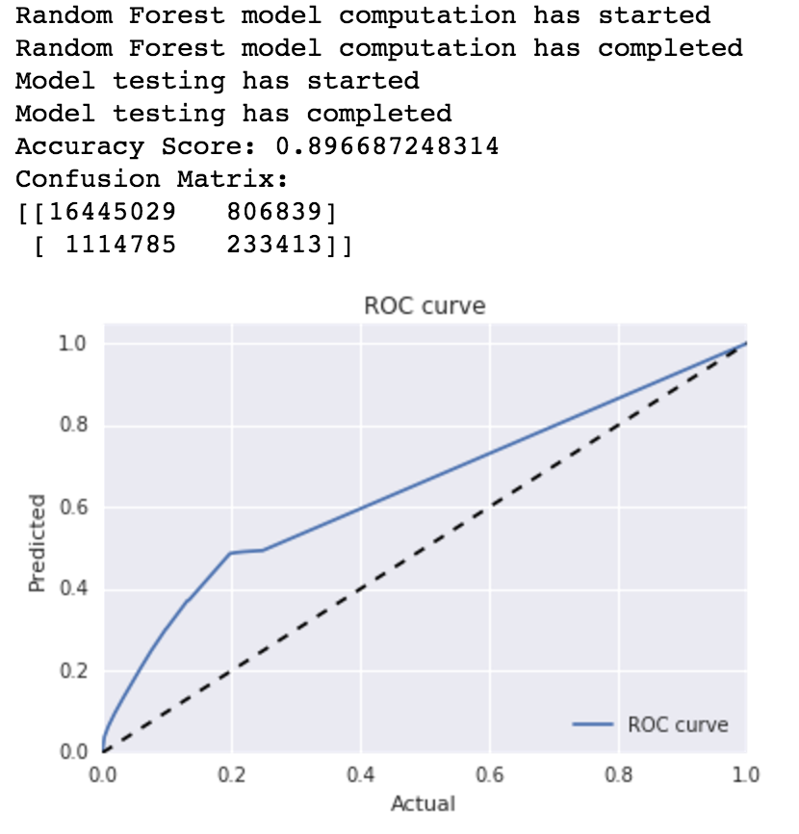
CLASSIFICATION Contd..
Random Forest Output:

Slide 22
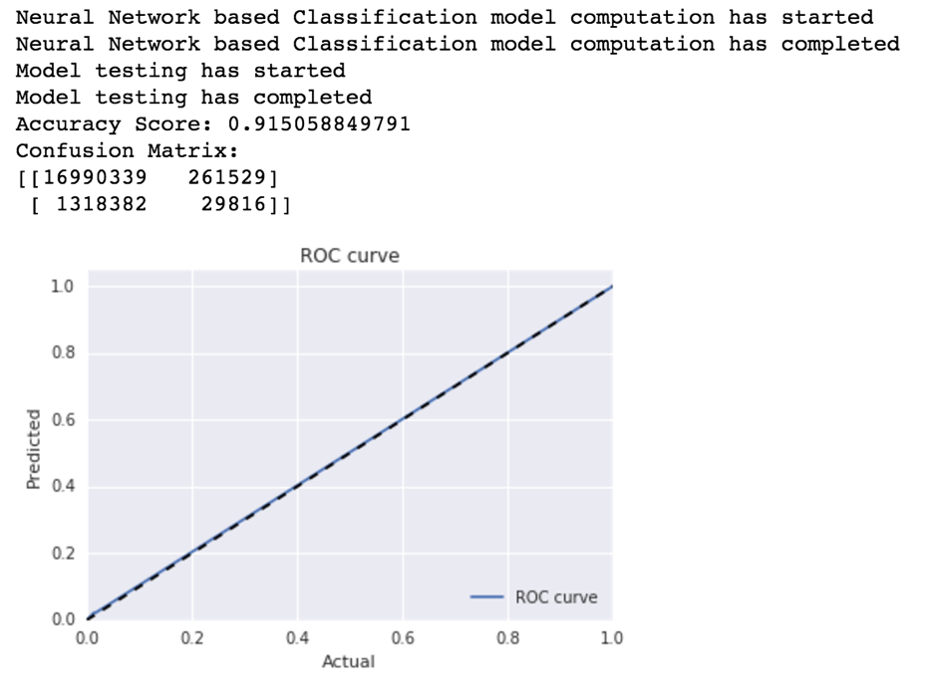
CLASSIFICATION Contd..
Neural Net Output:

Slide 23
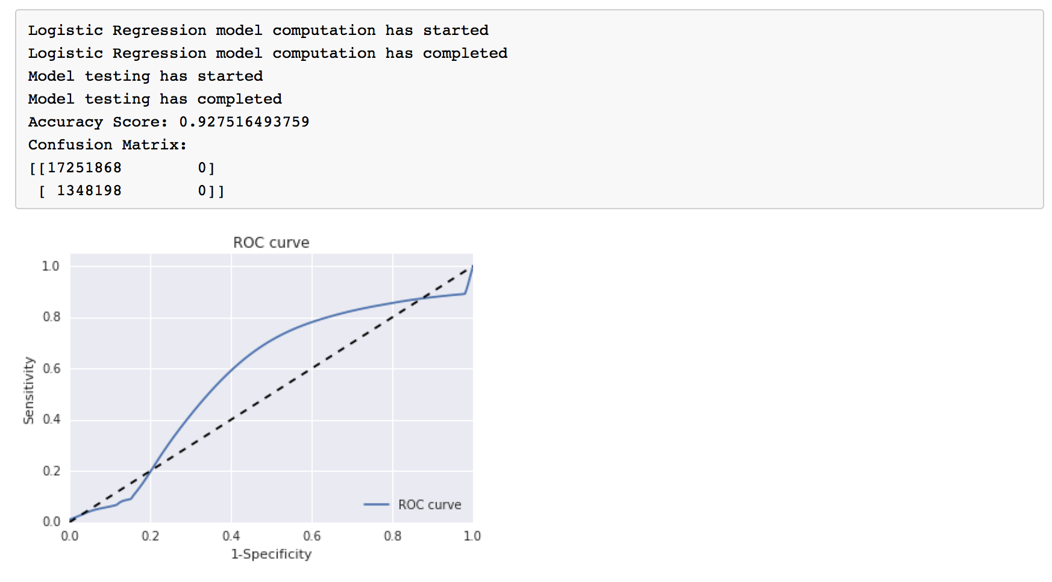
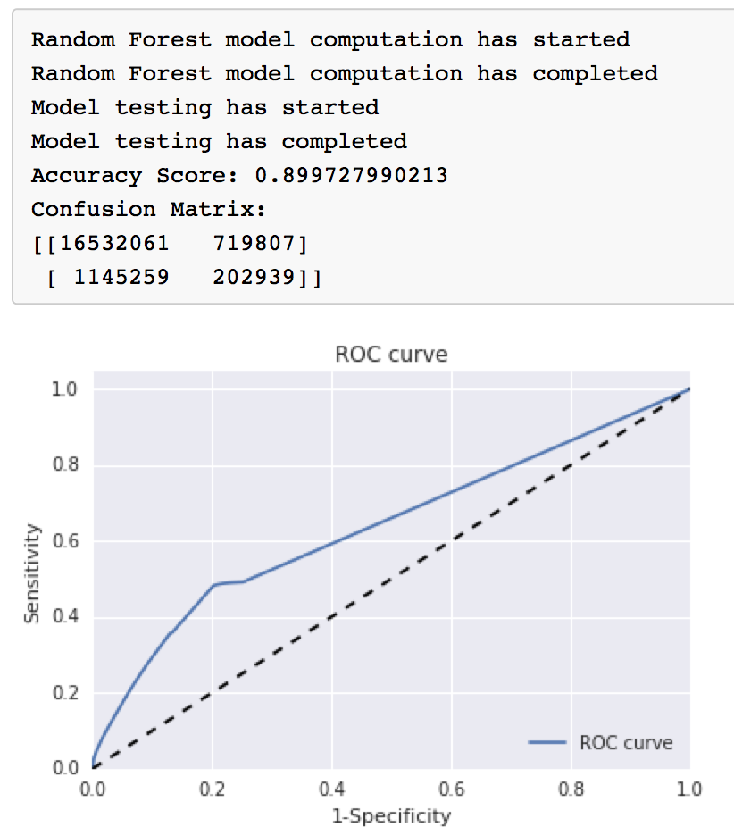
CLASSIFICATION Contd..
Feature Selection:
4 Features selected Rankings: (Q1 2006):

Slide 24
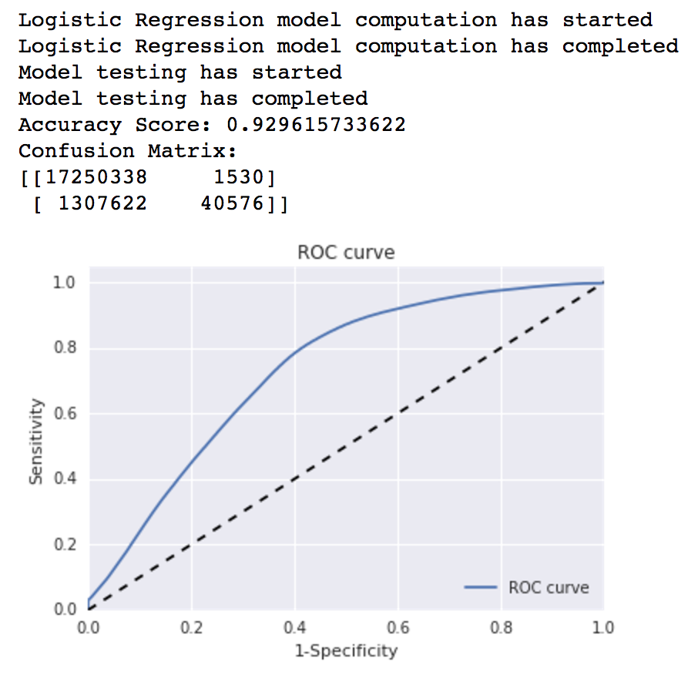
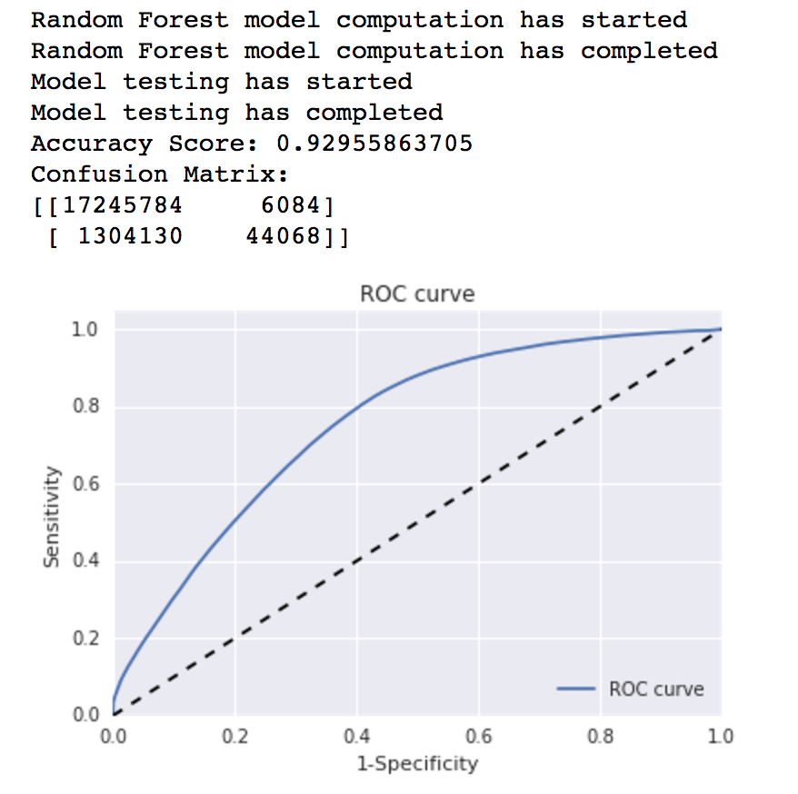
CLASSIFICATION Contd..
Feature Selection:
5 Features selected Rankings and Outcomes: (Q1 2006):

Slide 25
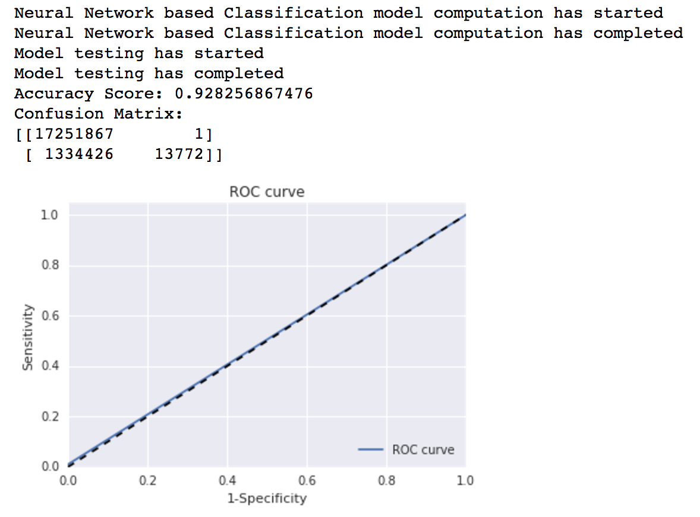
CLASSIFICATION Contd..
Feature Selection:
5 Features selected Rankings and Outcomes: (Q1 2006):
Neural Net

Slide 26
CLASSIFICATION Contd..
Feature Selection:
3 Features selected Rankings and Outcomes: (Q1 2006):

